Slide 1

Welcome
GUI Programming
with Java
Session 8
Choosers and Mouse Events

Slide 2

Objectives
We will look at…
  Using file choosers
  Mouse events

Slide 3
File Choosers
File choosers provide a GUI for navigating the file system.
They allow a user to choose a file or directory from a list or entering the name of a file or directory.
To display a file chooser, you usually use the JFileChooser API to show a modal dialog containing the file chooser.
Another way to present a file chooser is to add an instance of JFileChooser to a container.
Lecture3: Event Handing Slide

Slide 4
A JFileChooser object only presents the GUI for choosing files.
Your program is responsible for doing something with the chosen file, such as opening or saving it.
The JFileChooser API makes it easy to bring up open and save dialogs.
The look and feel determines what these standard dialogs look like and how they differ.

Slide 5
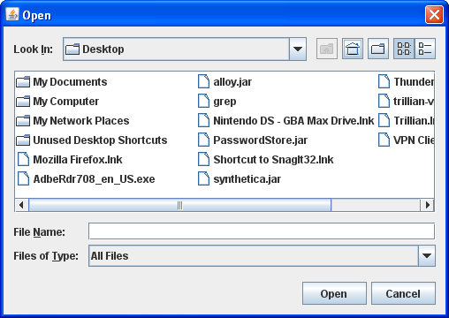
Here is a picture of the Java look and feel's standard open dialog:

Slide 6
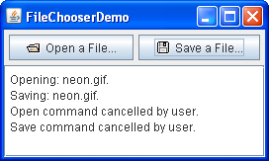
Lets now take a look at an example program which brings up an open dialog and a save dialog.
Let’s take a look at FileChooserDemo.java
in the sample 1 - file chooser folder.

Slide 7
Bringing up a standard open dialog requires only two lines of code:
//Create a file chooser
final JFileChooser fc = new JFileChooser();
...
//In response to a button click:
int returnVal = fc.showOpenDialog(aComponent);

Slide 8
int returnVal = fc.showOpenDialog(aComponent);
The argument to the showOpenDialog method specifies the parent component for the dialog.
The parent component affects the position of the dialog and the frame that the dialog depends on.
For example, the Java look and feel places the dialog directly over the parent component.
If the parent component is in a frame, then the dialog is dependent on that frame, disappearing when the frame is iconified and reappearing when the frame is deiconified.

Slide 9
Setting the directory
By default, a file chooser that hasn't been shown before displays all files in the user's home directory. You can specify the file chooser's initial directory using one of JFileChooser's other constructors, or you can set the directory with the setCurrentDirectory method.
Lets take a look at some of the constructors that may be of use to us.

Slide 10
Constructor Summary
JFileChooser()
Constructs a JFileChooser pointing to the user's default directory.
JFileChooser(File currentDirectory)
Constructs a JFileChooser using the given File as the path.
JFileChooser(String currentDirectoryPath)
Constructs a JFileChooser using the given path.

Slide 11
The call to showOpenDialog appears in the actionPerformed method of the Open a File... button's action listener:
public void actionPerformed(ActionEvent e) {
//Handle open button action.
if (e.getSource() == openButton) {
int returnVal = fc.showOpenDialog(FileChooserDemo.this);
if (returnVal == JFileChooser.APPROVE_OPTION) {
File file = fc.getSelectedFile();
//This is where a real application would open the file. log.append("Opening: " + file.getName() + "." + newline);
}
else {
log.append("Open command cancelled by user." + newline); }
}
... }

Slide 12
Using the file object
Remember that last semester you studied File IO which would have included a look at the File class.
You can call other methods on the File object, such as getPath, isDirectory, or exists to get information about the file.
You can also call other methods such as delete and rename to change the file in some way.
Of course, you might also want to open or save the file using one of the reader or writer classes provided by the Java platform.

Slide 13
The example program uses the same instance of JFileChooser to display a standard save dialog. This time the program calls showSaveDialog:
int returnVal = fc.showSaveDialog(FileChooserDemo.this);
By using the same file chooser instance to display its open and save dialogs, the program reaps these benefits:
    The chooser remembers the current directory between uses so the open and save versions automatically share the same current directory.
    You have to customize only one file chooser, and the customizations apply to both the open and save versions of it.

Slide 14
Finally, the example program has commented-out lines of code that let you change the file selection mode.
For example, the following line of code makes the file chooser able to select only directories, and not files:
fc.setFileSelectionMode(JFileChooser.DIRECTORIES_ONLY);

Slide 15
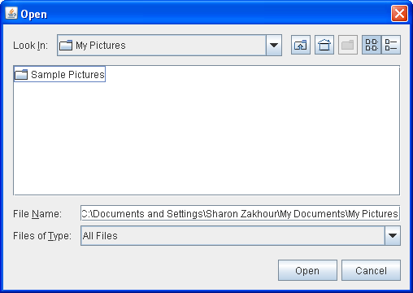
Another possible selection mode is FILES_AND_DIRECTORIES. The default is FILES_ONLY.
The following picture shows an open dialog with the file selection mode set to DIRECTORIES_ONLY.
Note that, in the Java look and feel at least, only directories are visible — not files.

Slide 16
Mouse Listeners and Mouse Events

Slide 17
There are numerous Mouse event classes and interfaces which are available in Java
Each of them attempt to handle different events using the Mouse
Mouse events are those associated with clicking, dragging, entering, exiting etc.
Mouse motion events are events that involve the mouse tracking across the screen, i.e., moving and dragging

Slide 18
Some of the classes/interfaces to deal with Mouse events are listed below; many of these will be covered in this lecture (most are in the java.awt.event package):
        MouseListener
        MouseMotionListener
        MouseEvent
        MouseInputListener
        MouseWheelListener
        MouseAdapter
        MouseInputAdapter

Slide 19
MouseListener
The MouseListener interface is used to respond to user mouse events
Specifically it contains handlers for 5 events, namely, mouseClicked, mouseEntered, mouseExited, mousePressed, mouseReleased

Slide 20
MouseListener
mouseClicked(MouseEvent)
Called when the mouse button has been clicked (pressed and released) on a component.
mouseEntered(MouseEvent)
Called when mouse enters a component
mouseExited(MouseEvent)
Called when mouse exits a component
mousePressed(MouseEvent)
Called when a mouse is pressed in a component
mouseReleased(MouseEvent)
Called when a mouse is released in a component

Slide 21
MouseListener
In order to listen for events at the class level using MouseListener you must add implements MouseListener to the class (import the java.awt.event package)
Once you implement this you will have to implement all five handler methods
You need only fully implement the handler method you are interested in, the others can be left blank…the compiler will not allow you to compile if you have not implemented all of the handler methods

Slide 22
MouseListener
        public class BlankMouseListener implements MouseListener {
        public void mouseClicked(MouseEvent e) { //implement here }
        public void mouseEntered(MouseEvent e) { //implement here }
        public void mouseExited(MouseEvent e) { //implement here }
        public void mousePressed(MouseEvent e) { //implement here }
        public void mouseReleased(MouseEvent e) { //implement here }
        }

Slide 23
MouseMotionListener
This listener is used to respond to the movement of the mouse as it tracks across the screen
These include the dragging and move events
The two handle methods are:
mouseDragged(MouseEvent e)
mouseMoved(MouseEvent e)

Slide 24
MouseMotionListener
        public class BlankMouseMotionExample implements MouseMotionListener {
        public void mouseDragged(MouseEvent e) {}
        public void mouseMoved(MouseEvent e) {}
        }

Slide 25
MouseEvent
In the two previous interface you can observe that a MouseEvent parameter is passed to all of the handler methods shown
The MouseEvent class is identical in its function to the ActionEvent parameter that we’ve already seen numerous times when using buttons
Just like the ActionEvent parameter the MouseEvent parameter receives an object of this type which represents the event which has occurred…and importantly contains information relating to the event that took place!

Slide 26
MouseEvent
The MouseEvent parameter is given a name, this reference name can be used to retrieve information about the event that took place
Many of the methods are the same as ActionEvent, however, many of them are specific to the mouse
Some of the mouse specific events are listed in the next slide [you can find them all online at: MouseEvent at Oracle Site]

Slide 27
MouseEvent
        Assuming that e is the name given to the MouseEvent parameter the below are examples of information that can be retrieved from the MouseEvent object:
        e.getX(); //The x co-ordinate of where the mouse event occurred with the component that has the listener added
        e.getY(); //The y co-ordinate of where the mouse event occurred with the component that has the listener added
        e.getXOnScreen(); //The x co-ordinate of where the mouse event occurred within the program screen [absolute x position]
        e.getYOnScreen(); //The y co-ordinate of where the mouse event occurred within the program screen [absolute y position]

Slide 28
MouseInputListener
This interface allows us to implement both the MouseListener and MouseMotionListener at the same time
Implementing this interface requires the implementation of the five MouseListener handler methods AND the two MouseMotionListener handler methods
The MouseInputListener is found in the javax.swing.event package
[see more here MouseInputListener on Oracle site]

Slide 29
MouseWheelListener
This interface can be implements to respond to mouse wheel events
There is only one handler in this interface, namely,
mouseWheelMoved(MouseWheelEvent e)

Slide 30
MouseAdapter
Sometimes you may wish to only implement one-or-two of the mouse methods
An Adapter is a design pattern which allows use to adapt classes that already exist in some way
The MouseAdapter class implements the MouseListener, MouseMotionListener and MouseWheelListener interfaces
You can extend the MouseAdapter and you need only implement the handler you wish (example on next slide)

Slide 31
MouseAdapter
import java.awt.event.MouseAdapter;
import java.awt.event.MouseEvent;
public class BlankMouseAdapterExample extends MouseAdapter {
public void mouseClicked(MouseEvent e) {} //Compiler happy to allow just one
}

Slide 32
MouseAdapter
The advantage of the MouseAdapter is that only the method/methods that are required need to be implemented and so the code is much less congested
The disadvantage of the MouseAdapter is that it requires the use of the extends keyword which limits the inheritance to ONE class
Therefore if your class needs to inherit from another class (e.g. JFrame) you cannot inherit from another and the implements may have to be used (or a second external listener)

Slide 33
Other Adapters in GUI Programming
The following are some of the adapter classes available in Java GUI programming, all with same purpose:
        ComponentAdapter
        ContainerAdapter
        FocusAdapter
        KeyAdapter
        MouseAdapter
        MouseMotionAdapter
        MouseInputAdapter
        WindowAdapter

Slide 34
Making the Mouse events respond
The steps are the same as for other listeners
Implement the listener
Add the listener to the component
Implement the handler methods required
See the example on Moodle called MouseListenExample.java

Slide 35
Exercises for this week
Create a program that a Java Jframe program that launches a JFileChooser. You need not worry about implementing the code to modify files, just instantiate the chooser and explore with it.
Create a mouse program that has a JLabel in the middle of the screen. Make the JLabel display the name of the MouseEvent that occurs [include all events in the MouseInputListener]

Slide 36
End of Session
END OF SESSION

